Slide 1




A Representation Learning Framework for Property Graphs
2019 Anchorage, Alaska USA
Yifan Hou, Hongzhi Chen, Changji Li, James Cheng, Ming-Chang Yang, $et al$
The Chinese University of Hong Kong
Notes:
Hello everyone, this video I’ll talk about our paper titled ``A representation learning framework for property graphs’’, which is accepted in KDD two thousand and nineteen.

Slide 2
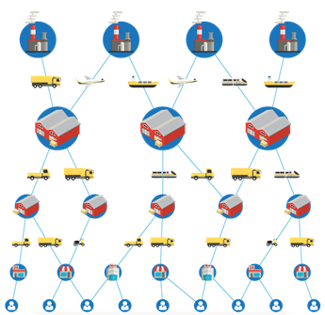

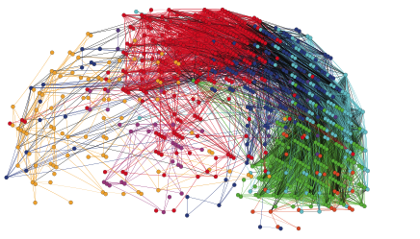
Why graphs ?
Graph models are ubiquitous and pervasive for describing complex information.
biological graphs (human brain)
online social networks
supply graphs for ecommerce platforms
Notes:
Graphs are ubiquitous due to the flexibility of using graphs to model data in a wide spectrum of applications. 8.45 Many complex information can be described by graph models easily. 13 For example the biological graphs. 15.89 It presents the relationships between many small regions in human brain specialized for processing certain types of information. 24 The online social networks that represents the friend relationship between users. 29.41 And the supply-graphs for the ecommerce platforms, showing how to transport products to users after the order.

Slide 3
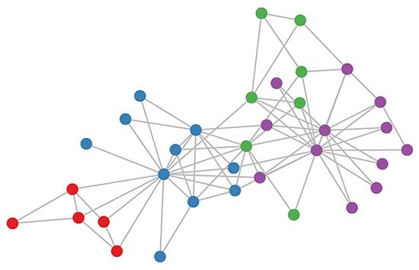
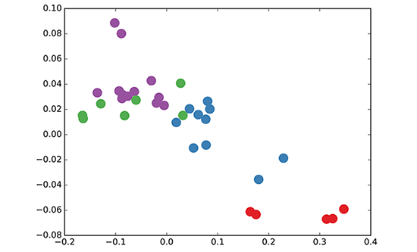
Why we need graph representation learning ?
Graphs are non-Euclidean
the number of nodes are arbitrary
their connections are also arbitrary
mapping each node into a low-dimensional space
Notes:
If we want to do some machine learning tasks on graphs, for a simple example like we want to classify the nodes, things will become much more complicated since graphs are non-Euclidean data. 11 Simply speaking, we cannot promise that every graph has the same number of nodes, and different nodes turn to have different number of connected neighbors. 19.40 Therefore people try to map each node into a low-dimensional Euclidean space, while preserving most of the graph information like its topology. 29.58 That’s graph representation learning, also called graph embedding.

Slide 4
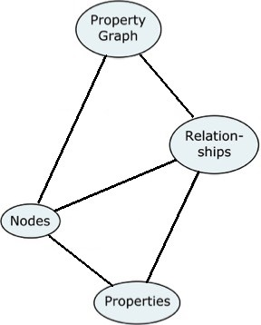
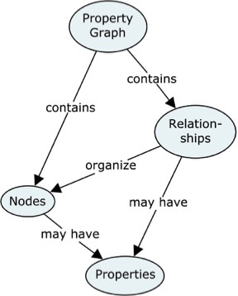
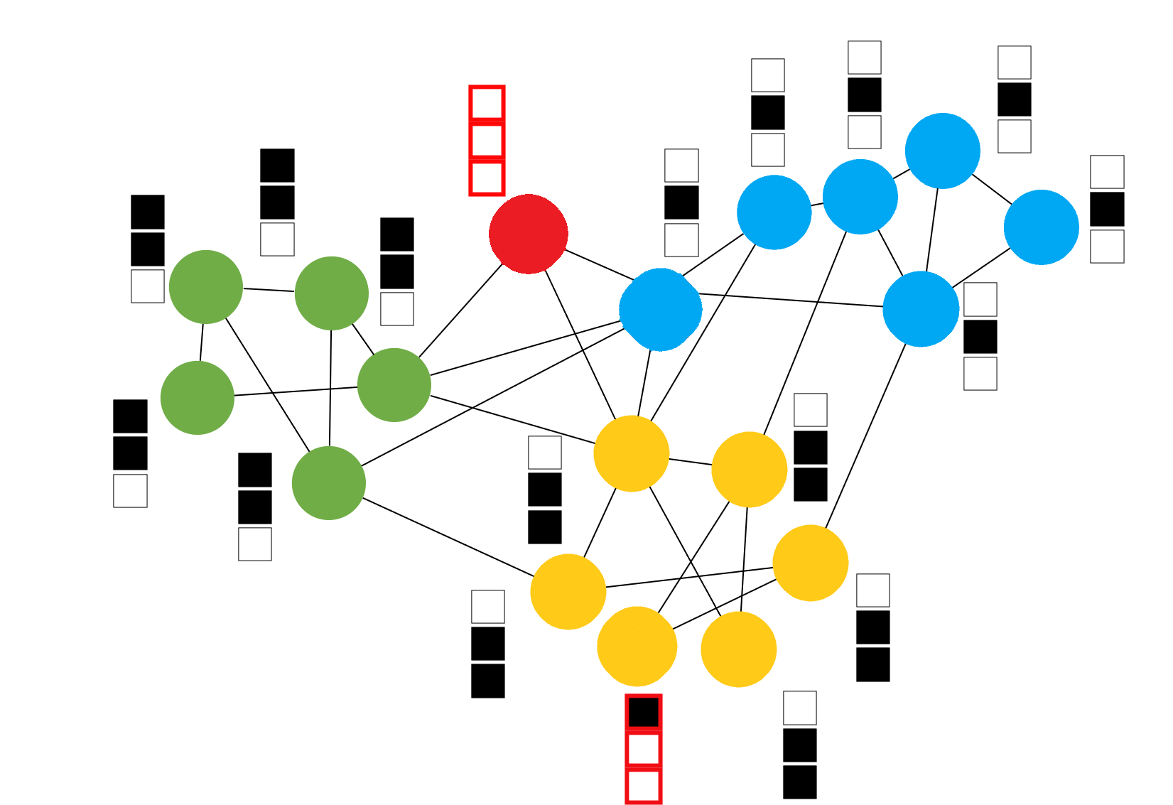
Challenge: attributed graphs are not sufficient
property graph contains nodes and relationships, where nodes are organized by relationships. And both nodes and relationships may have some properties.
Using graphs (with no edge info) is hard to describe the information
while property graph can handle it well.
Notes:
However, most existing graph embedding methods either focus on plain graphs with only the graph topology, or consider properties on nodes only. 9 This kind of graph data cannot describe the information exactly. 13 For example if we want to describe the information about what the property graph is. 17.75 We say property graph contains nodes and relationships, where nodes are organized by relationships. And both nodes and relationships may have properties. 27.5 Using attribute graph we can only know this four things have some relationships between them. 32.42 However if we use property graph model, there is no information loss at all. 37.6 Actually most graph databases hold the data with that format.

Slide 5
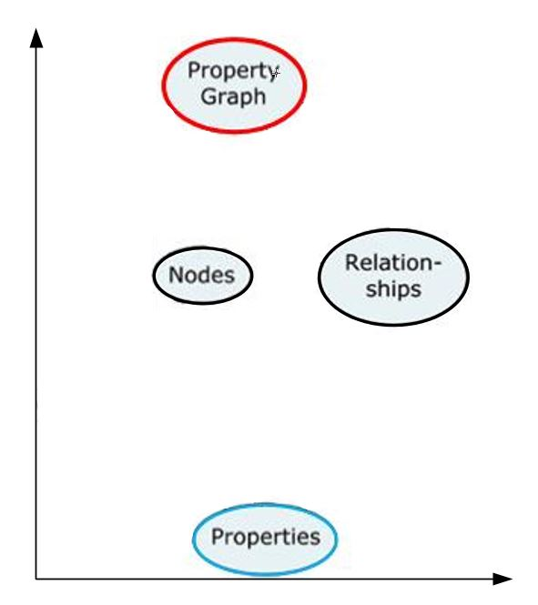
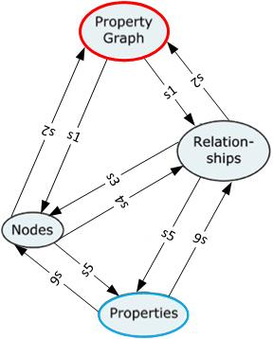
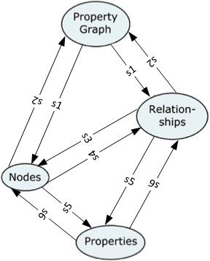
Solution: PGE framework
Different kinds of relationships have different roles!
contains —> strategy s1
contains <— strategy s2
organize —> strategy s3
organize <— strategy s4
may have —> strategy s5
may have <— strategy s6
Notes:
Therefore to solve that problem, we propose PGE, a graph representation learning framework that incorporates both node and edge properties into the graph embedding procedure. PGE adopts the popular inductive model for neighborhood aggregation and utilizes different strategies to handle different kinds of relationships. Besides, PGE uses node clustering to assign biases to differentiate neighbors of a node and leverages multiple data-driven matrices to aggregate the property information of neighbors sampled based on a biased strategy. For example if PGE clusters the nodes into three types, red black and blue presented with circle line. It may capture that for ``nodes’’, ``relationships’’ is more important than ``properties‘’.

Slide 6
A Representation Learning Framework for Property Graphs
Yifan Hou, et al
Department of Computer Science and Engineering
The Chinese University of Hong Kong
Notes:
Music…

